Slide 1

WAY TO ENTERPRISE
Java

Slide 2
Agenda
Setup JDK
Setup Eclipse
Copyright © VTI Academy All Rights Reserved

Slide 3
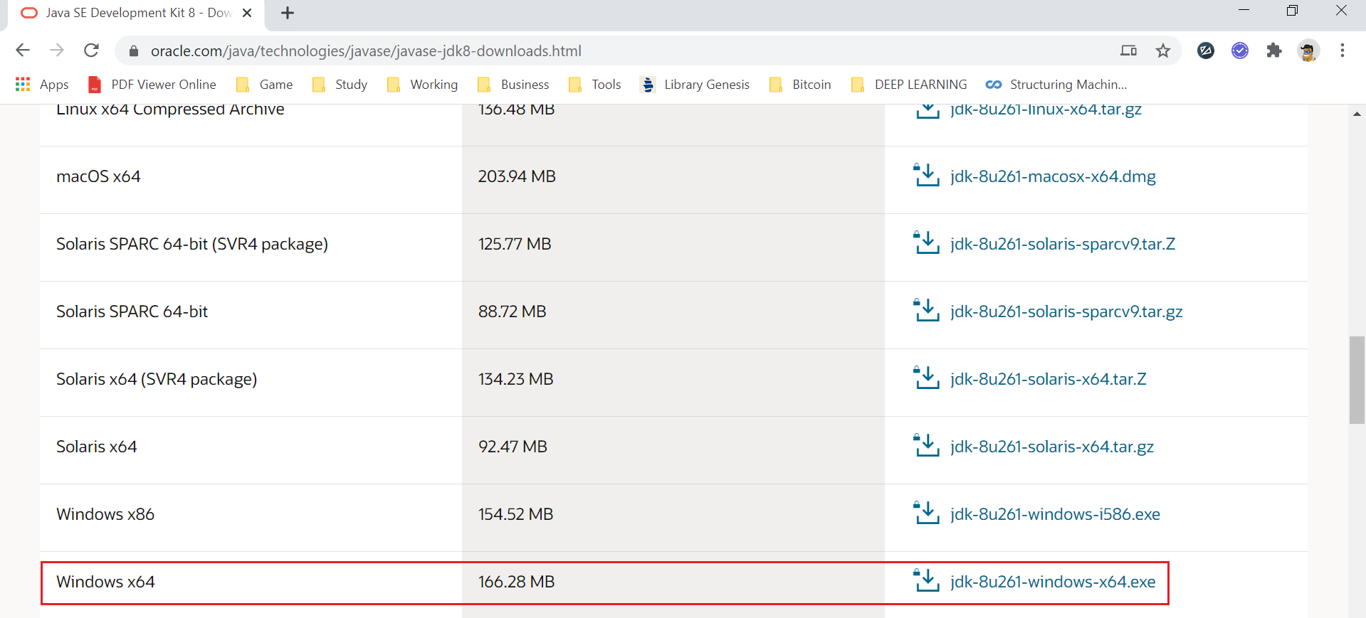
Setup JDK
https://www.oracle.com/java/technologies/javase/javase-jdk8-downloads.html

Slide 4
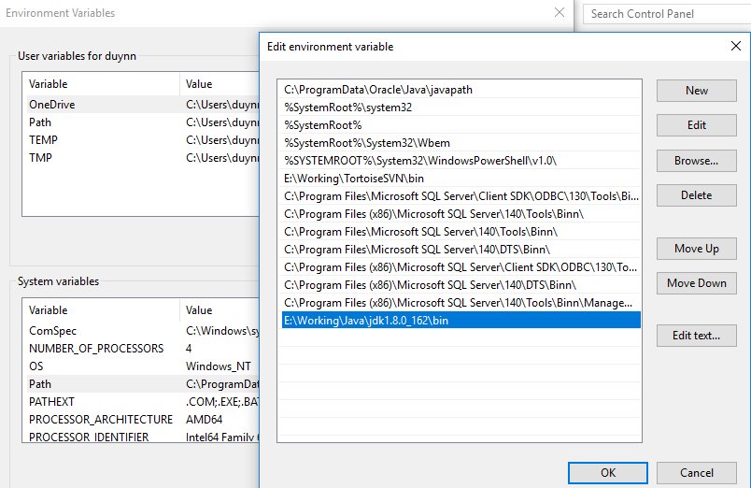
Setup JDK
This PC → Properties → Advanced system settings → Advanced → Environment Variables → system variables → path
https://mkyong.com/java/how-to-set-java_home-on-windows-10/

Slide 5
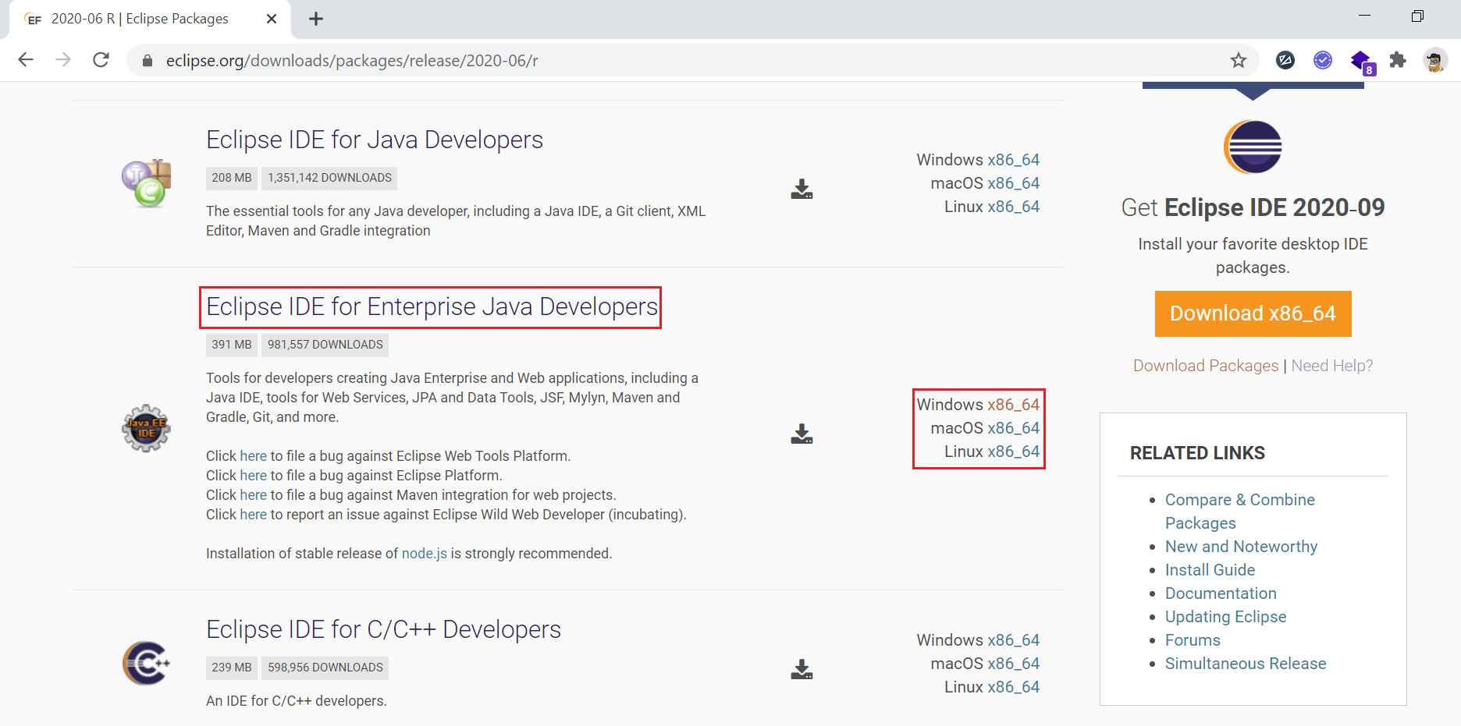
Setup Eclipse
https://www.eclipse.org/downloads/packages/release/2020-06/r

Slide 6
Q & A
Copyright © VTI Academy All Rights Reserved

